Slide 1

THEATER NURSING BY

Slide 2
OBJECTIVES
Describe how to promote safety and infection prevention
General layout
Demonstrate ability to scrub, mask, gown
Prepare a typical theatre day

Slide 3
Describe the co-ordination of activities in theatre
Co-ordination of staff
Communication with surgical ward nurses/depts
Nursing care of patients in OT
Describe the measures to be taken in ensuring quality care in OT

Slide 4
INTRODUCTION AND DEFINITIONS
Theater nurses are nurses who are offering comprehensive specialized care in a specialized unit.
They are categorized as scrub, anesthetic, circulating and recovery nurses. They all practice within the scope of their profession

Slide 5
HISTORY OF THEATER NURSING
In the 16th BC the ancient Greeks and Romans
used strings as ligatures before discovering hot iron to prevent hemorrhage
17th BC Napoleon used alcohol and opium to relieve pain while performing an amputation
1772 Joseph Priestly discovered use of nitrous oxide as anesthesia

Slide 6
1800 – senior nurses worked in operating theatre
1842- Dr Crawford discovered the use of ether for anesthesia
1847 – James Young discovered chloroform
1865- Joseph Lister used carbonic acid to reduce the growth of bacteria in wounds
1875 first lecture on surgical instrument was given at John Hopkins university

Slide 7
1886- Von Bergemen introduced sterilization of dressings
1890- gloves were introduced as part of surgery
By the end of the 18th century muscle relaxants were discovered ( trilene thiopentone, clytopopaine and curare)
1900- hospital based program added surgery in the curriculum where nurses were to undertake theatre rotation as part of their training

Slide 8
1910- it was passed that the senior nurse would circulate and the students would scrub
1919- clinical instructors were introduced in theatre to guide students
1940-1960- theatre technicians were taught on how to scrub due to deficiency of nursing staff
1978 – theatre nursing was introduced and revised in 1982

Slide 9
LEGAL ASPECTS OF THEATER NURSING
Legal – required/permitted by law
Dfn- what the law requires the theatre team to do in theatre before, during and after the operation
1. Informed consent
Explain the operation to be performed
Importance of the procedure
Its effects ( good and bad )

Slide 10
NB- for patients below 18 years and the mentally ill, the parents should give the consent
Consent must be given when the patient has a sound mind i.e.- not under influence of anything.
2. Confidentiality
The information about the patient should only be shared with those taking part in the care of the patient

Slide 11
Therefore the following should be considered:
Any patient going to theatre:
must be well prepared preoperatively
Must sign an informed consent, obtained by the surgeon
Must be protected from harm, falls or eventualities during the stay in theatre
Must have confidentiality maintained at all times

Slide 12
Measures must be taken to ensure that the patient taken to theatre is the right one and has been done the intended operation
The items to be used for the procedure must be counted and recorded before and after procedure to prevent any losses

Slide 13
Theatre nurse must know where the exits are, for use incase of any emergency
Sockets in theatre should be covered during scrubbing to prevent the risk of conducting current i.e should be one meter or more above the floor
All electrical machine should be checked to ascertain optimum function before use on the patient

Slide 14
PREOPERATIVE CARE
Make sure the surgeon has explained clearly to the patient about what will happen
The surgeon should obtain an informed consent from the patient/ parent /guardian or next of kin
The nurse ensures that the patient has signed the consent, after the surgeon has explained the advantages and outcome of the operation

Slide 15
Make sure the patient observes the “nil by mouth rule”
Blood works should be within the acceptable limits
The patients should be counseled and reassured, especially those undertaking major procedures e.g amputation, mastectomy , hysterectomy etc

Slide 16
Skin preparation of the area being operated on should be done
Catheterization and IV branula insertion
Observation of the vital signs, urine testing, blood sugars should be done
The receiving nurse should confirm that the above measures have been done before receiving the patient to theatre

Slide 17
LAYOUT OF A THEATRE
LOCATION
should be built in a central place possibly near the ICU,HDU and surgical wards
All these units should be in relation to each other but the construction should be separate and independent from all traffic and air movement from the hospital

Slide 18
WALLS
Walls, floor and roof should be built with materials that can be easily cleaned. The corners are rounded and seamless
The drainage should good due to the regular disinfection between procedures
LIGHTING
The should be efficient natural/artificial light
Emergency power system incase of power failure

Slide 19
EQUIPMENTS
Furnishings and fittings should be made of stainless steel for quick and thorough cleaning
- All trolleys are fitted with non-electrical conducting rubber to minimize the risk of electric conduction
VENTILATION
Ceilings should be high enough
Should have enough ventilators i.e natural/artificial to allow escape of gases

Slide 20
SPACE
The doors and corridors should be wide and high for easy movements
The rooms should be spacious for easy delivery of services.

Slide 21
ROOMS IN OPERATING THEATRE
Administrative offices
Transfer area
Anesthetic room
Scrub up areas
Operating suite with operating tables
Adjacent to it a sluice room i.e. each operating room should have a sluice room

Slide 22
Rest rooms
Changing rooms ( male and female )
Storage rooms for procured materials
Storage rooms for sterile equipments
A control sterile processing area with a working sterilizer
Linen room
Shower rooms/ toilets

Slide 23
AREAS IN OPERATING THEATRE
Non – restricted area
This includes the changing rooms and the transfer area
Allows contact of the theatre staff and other hospital staff
Theatre staff in this area don’t have sterile attire or mask

Slide 24
Semi-restricted area
Transfer is restricted to the theatre staff properly dressed
Don’t have sterile attire
Head and the rest of the body is covered with theatre attire
Includes the offices’, stores, resting room, corridors, recovery room

Slide 25
Restricted areas
Masks are needed for every member getting to this area
Assisting team don’t have sterile theatre attire
When the pack is opened/exposed everyone must have a mask
Surgical team must have sterile gowns & gloves and must not move from the room until operation is complete

Slide 26
The doors must be closed throughout the procedure
Unnecessary traffic should be avoided to prevent transfer of infection
This includes the scrub up areas, operating rooms, preparation area and sterilization areas

Slide 27
INFECTION PREVENTION
Principles of aseptic technique
Micro-organism move through space and air current. Therefore avoid shaking of linen or motion that creates air current on which micro-organisms can be transported
Micro-organisms are transferred from one surface to another whenever non-sterile objects touches another object

Slide 28
Micro-organisms move slowly on dry surfaces but very quickly through moisture
Micro-organisms are transferred through gravity when an object is held above the other i.e. avoid passing dirty objects over clean ones
Micro-organisms are passed into the air through droplet nuclei when a person breathes, speaks or pits

Slide 29
Because micro-organisms are in constant motion in a variety of ways, sterile areas must be protected by maintaining margins of safety of not less than 30cm,and also when passing by
Proper hand washing removes many micro-organisms that would be transferred by the hands from one place to another

Slide 30
Preparation of the operating room
Theatre room has to be cleaned every morning with soap and water and a disinfection
High dusting of walls, trolleys , drip stands , operating tables and equipment should be done every morning
Drying the theatre table and placing it below the overhead operating lights

Slide 31
Keeping a clean drape on the theatre table
Set the anesthetic machine to ensure it is in good working condition
Order the operating equipments from the sterilizing room
Taking of the swabs from time to time

Slide 32
Preparation of the nurse
Go straight to the changing room and change to theatre attire and boots
Cover the head with a head cap
Avoid movements in and out of theatre
If this happens change into new theatre attire
NB– If you have a respiratory infection you are advised not to get to the operating room

Slide 33
scrubbing
This is done to remove micro- organisms from the forearms by mechanical washing and chemical disinfections before taking part in the surgical procedure.
This helps prevent the possibility of the patient being contaminated by bacteria from the hands and arms

Slide 34
-It involves the following
The theatre suit should have the top/shirt tidily tucked in
A cap should be worn to cover all the hairs, tie the tape at the back
A mask should be worn with the short side above the nose and the long side extending to under the chin
Remove all jewellery e.g wedding ring , ear rings, watches etc

Slide 35
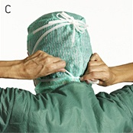
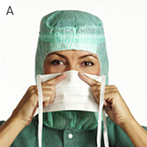
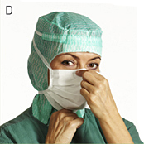
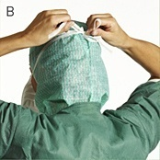
Donning guide: Surgical mask with tie-band
A. Pre-form the nose-clip. Place the surgical mask on your face making sure to cover your nose and mouth.
C. Position the lower tie-bands at the nape of your neck and tighten.
B. Position the upper tie-bands at the crown of your head and tighten securely to minimize air leakage.
D. Always unfold the mask fully to minimize the number of layers you have to breathe through.

Slide 36
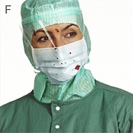
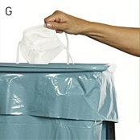
E. Change surgical mask when contaminated as well as between operations.
F. When there is a risk of fluid splashes use a splash resistant surgical mask and protective eyewear or a splash resistant surgical mask with a visor.
G. Dispose of the surgical mask after use.

Slide 37
Finger nails must be short and clean with no nail varnish
No cut wounds or septic wound on fingers
No persons with upper respiratory tract infection or gastroenteritis should be allowed to theatre
Wear a mackintosh apron to protect the theatre scrubs
Then start the scrubbing procedure

Slide 38
Scrubbing procedure
Use the wall clock to time yourself
Wet the hands and arms to the elbow
Pick the soap and make a lot of lather on the hands and arms
Wash hands and arms for one minute
Keeping the fingertips uppermost all time , rinse hands to the elbow

Slide 39
Using the elbow, press the hutch of the dispenser and pick one sterile brush
Starting with the left arm scrub the fingernails, move to the fingers and palms using a circular movement inside the palm
Spend extra time at the folds of the wrist
( 1min 30 seconds) rinsing often and starting again. Rinse the right palm and brush
Change to the right hand and repeat the procedure

Slide 40
Take precaution to avoid touching of the tap during the procedure
When rinsing do it only in one direction from the fingers to the elbow
Close the tap with the elbow. Keeping hands together upright
Circulating nurse will remove the mackintosh

Slide 41
Drying
Pick up the towel and step back
Start with the left hand and blot dry the fingers , the webs of the hand and the palm
Move to the back of the hand, fore arm using a circular movements to the elbows
Using the dry part of the towel
Repeat the same procedure on the other arm

Slide 42
Gowning
Pick a gown and step back
Hold the neck band and let the bottom hem drop
Open the gown and slide both hands in through the arm holes
Don’t touch the outside of the gown with your bare hands
The runner nurse ties the neck and shoulder bands then wristbands without touching the gown

Slide 43
Skin preparations
Depends on the area of the operation
Sponge the skin with a disinfectant e.g hibitane in spirit
After sponging, the area is swabbed with iodine in spirit or hibitane 5% in 70% alcohol

Slide 44
Draping the patient
This helps maintain an adequate sterile field during the operation
Scrub nurse gives the surgeon the sterile drapes
The surgeon covers the area above, below the operation site and the sides
The drapes are secured with clips

Slide 45
Positioning the patient
This is done by other team members who have not scrubbed
The patient is positioned before skin preparation and draping
It includes placing the patient to the desired level of surgery.

Slide 46
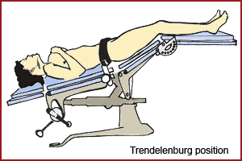
TRENDELENBURG POSITION
Common for pelvic operations
Patient is in supine ,head lowered and the knees are flexed

Slide 47
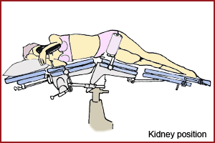
Kidney position

Slide 48
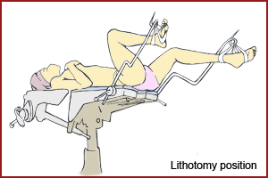
Lithotomy position
Used for perineal operations

Slide 49
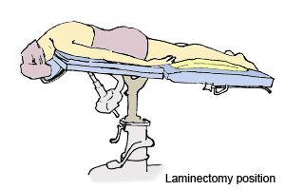
Laminectomy position
Operation involving the spine

Slide 50
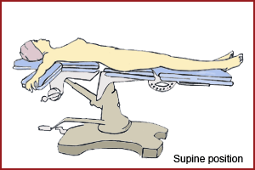
Supine position
Commonly used position in surgery

Slide 51
Sutures AND ligatures
Suture is a stitch used to bring living tissues together until the normal healing process takes place
Ligature- is a suture used for tying a blood vessel to arrest bleeding

Slide 52
TYPES OF SUTURES
Absorbable sutures are used to stitch the inner tissues and some times the skin
Non- absorbable sutures are used as ligatures and also to stitch the skin

Slide 53
Absorbable natural
Collagen
Plain surgical gut
Fast-absorbing surgical gut
Chromic surgical gut
Absorbable synthetic
Polyglactin 910 (Vicryl)
Polycaprolate (Dexon II)
Poliglecaprone 25 (Monocryl)

Slide 54

Polysorb
Polydioxanone (PDS II)
Maxon
V-Loc

Slide 55
Metal clips/staples
Can also be used as ligatures ,compress nerve endings and give a grip on the incision site

Slide 56
Non-absorbable natural
Non-absorbable synthetic
Surgical silk
Surgical cotton
Surgical steel
Nylon
Polyester fiber (Mersilene/
Surgidac [uncoated]and Ethibond/
Ticron[coated]

Slide 57
Polybutester Suture (Novafil)
Coated Polybutester Suture (Vascufil)
Polypropylene (Prolene)
Surgipro II

Slide 58
NEEDLES
Characteristics of a good needle
Strong enough so it does not break easily
Rigid enough to prevent excessive bending yet flexible enough to prevent breaking in case of bending
Sharp enough to penetrate tissue with minimal resistance yet not stronger than the tissue it penetrates

Slide 59
Approximately the same diameter as the suture material it carries to minimize trauma in passage through tissue
Appropriate in shape and size for the type of condition and accessibility of the tissue to be sutured
Free from corrosion and burns to prevent tissue trauma

Slide 60
CLASSIFICATION OF NEEDLES
According to the eye
Regular eyed- threaded like ordinary sewing thread
Eyeless or swaged
2. According to the shape of the shaft, straight or
curved.

Slide 61
Straight – used primarily for skin closure
Curved – used inside for quickly recovery of the point of needle

Slide 62
3. Cutting or non cutting
non- cutting
Rounded bodied and are used on tissue that offers a small amount of resistance to the needle as it passes through e.g. viscera, muscle

Slide 63
b) Cutting
They make a slight tear in tissue and the suture tends to cut it a little more
Used for tough tissues that a round needle cannot well go through such as tendon , peritoneum, fascia, subcutaneous and skin

Slide 64
General set of instruments
5 Rampley sponge holding forceps
2 Bard parker handle No. 4
1 Bard parker handle No. 3
1 Mayo scissor curved
1 mayo scissor straight
1 Cartless ligature scissors
1 Dissecting forceps toothed
1 Dissecting forceps non- toothed

Slide 65
1 Dunhill artery forceps
10 Chances artery forceps curved or flat
10 Spencer well curved or straight
4 Little wood tissue forceps
2 Lane tissue forceps

Slide 66
4 Allis tissue forceps
2 Langerbeek retractors
2 Canny Ryalls retractors
1 Lister Sinus forceps
1 Watson cheyne probe and dissector

Slide 67
1 Stanley Boyd's bone curette
1 Silver probe
2 Sinus needle holder
10 Shardless cross action towel clip

Slide 68
1 mayo pins
1 yankaur sucker tube
1 yankaur universal sucker handle
1 yankaur sucker tube (fine & medium)
1Pressure tube anti-static 2 meters' long diathermy heed

Slide 69
1 diathermy handle with ball or riches forceps
1 Edinburch tray
1 spring cord
1Green wrapper large
1 White wrapper
1 basic pack containing 2 bundles raytec gauze
( 20 ), 10 green towels, 1 abdominal sheet, 1 chest sheet and 1 mayo cover.

Slide 70
Surgical Instruments
Grasping and Clamping
Retracting
Cutting and Dissecting
Probing and Dilating

Slide 71
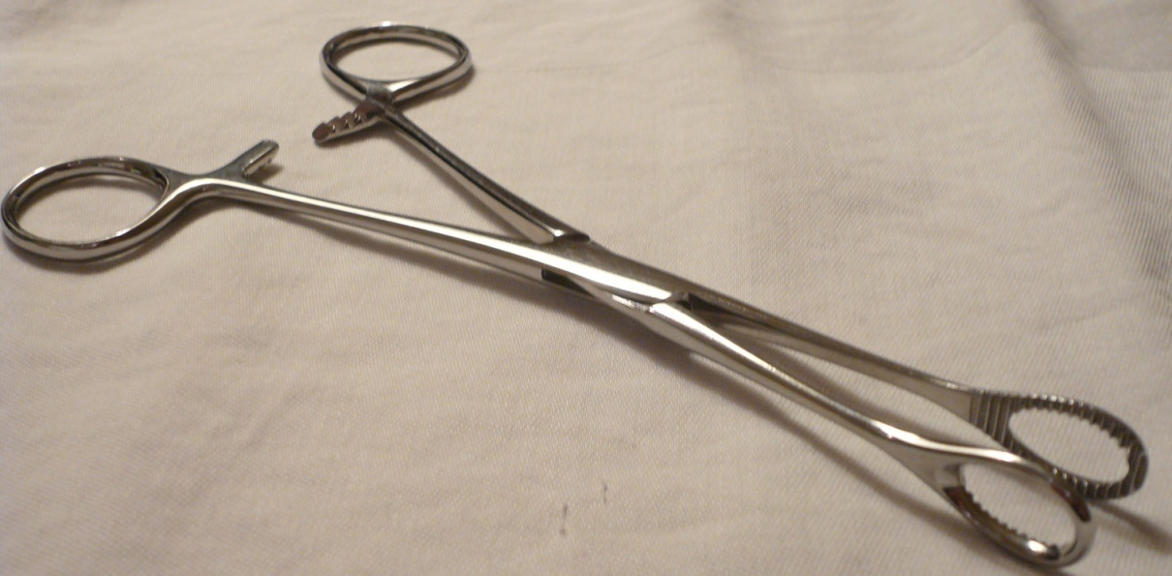
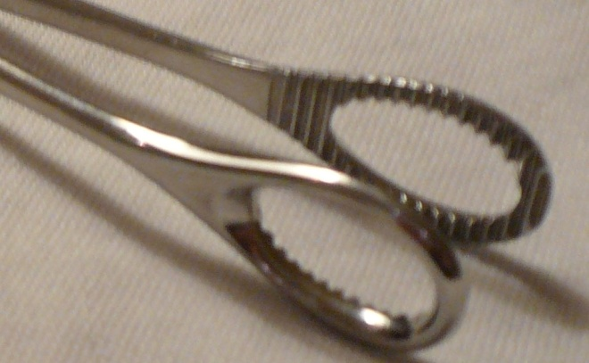
Sponge Forceps
Used to hold gauze squares or sponge to “mop up” the surgical site
Jaws are serrated

Slide 72
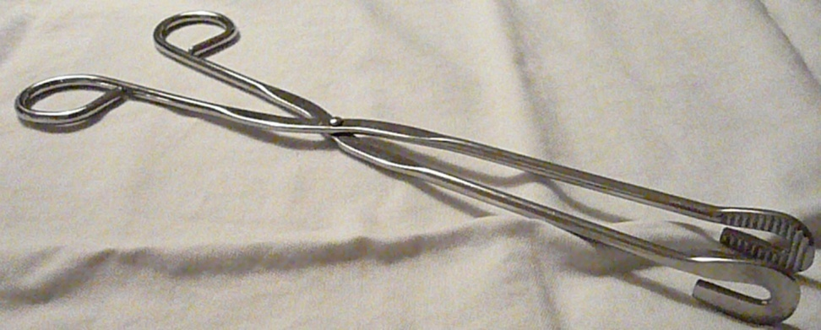
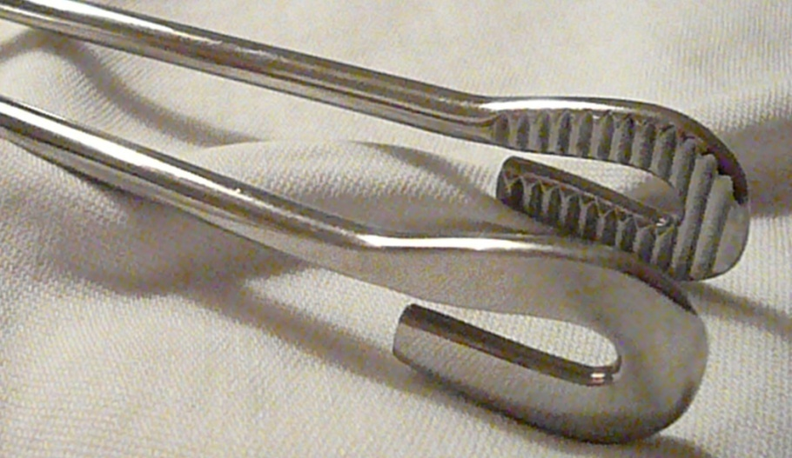
Transfer Forceps
When sterile, transfer
forceps;
arrange items on sterile tray
transfer items to sterile field

Slide 73
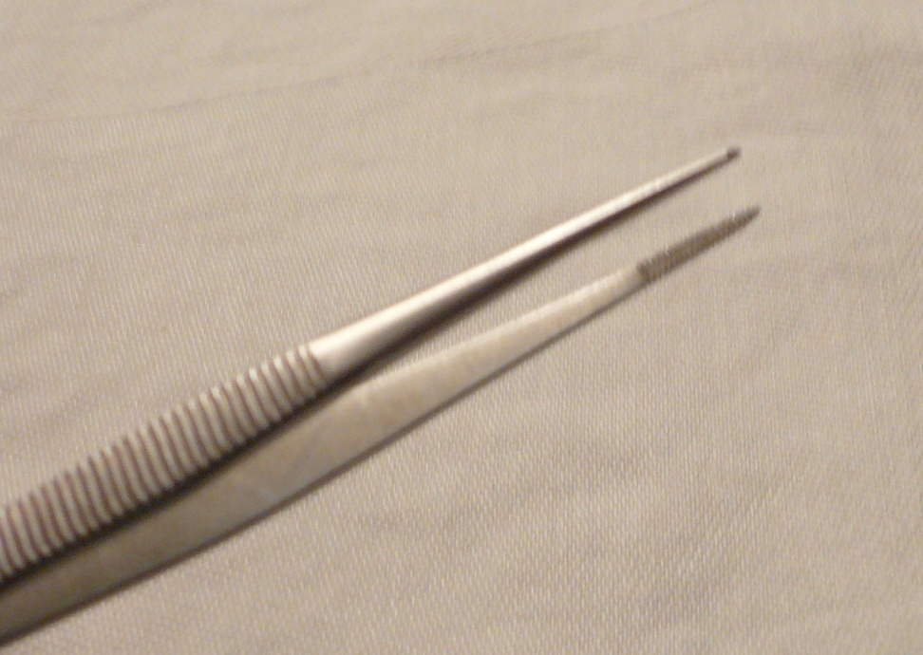
Splinter Forceps
Fine tip for foreign object retrieval

Slide 74
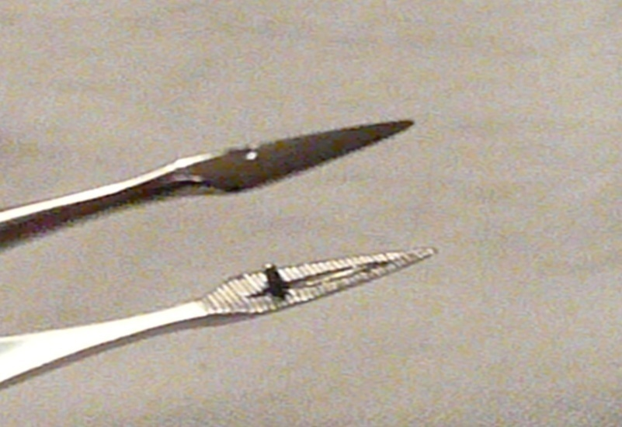
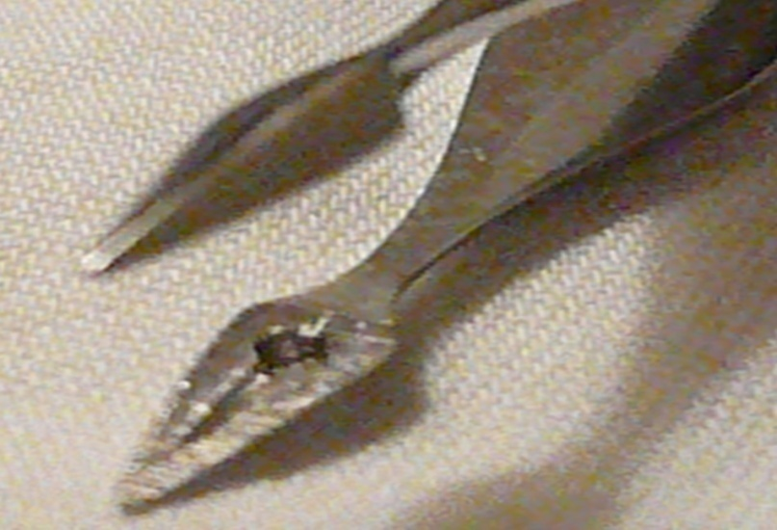
Walter Splinter Forceps
Very fine tip
Spear-head design

Slide 75
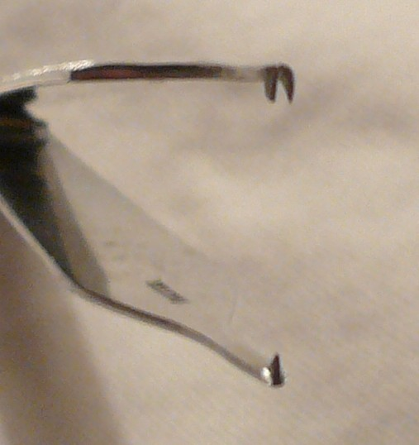
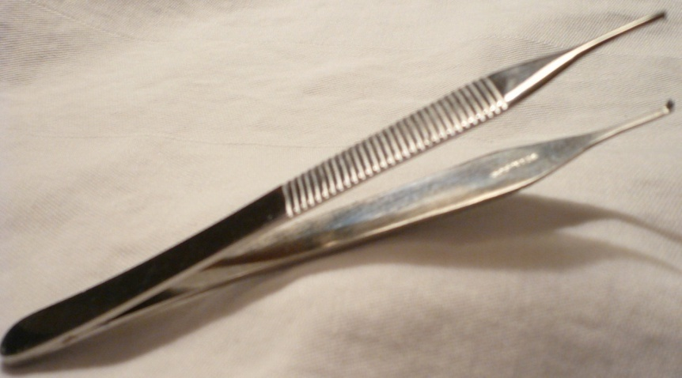
1x2 Toothed Tissue Forceps
Used for grasping and holding tissue, muscle or skin surrounding a wound
Single toothed on one side; fits between two teeth on the other side
Available as 1x2 or 2x3 or 3x4

Slide 76
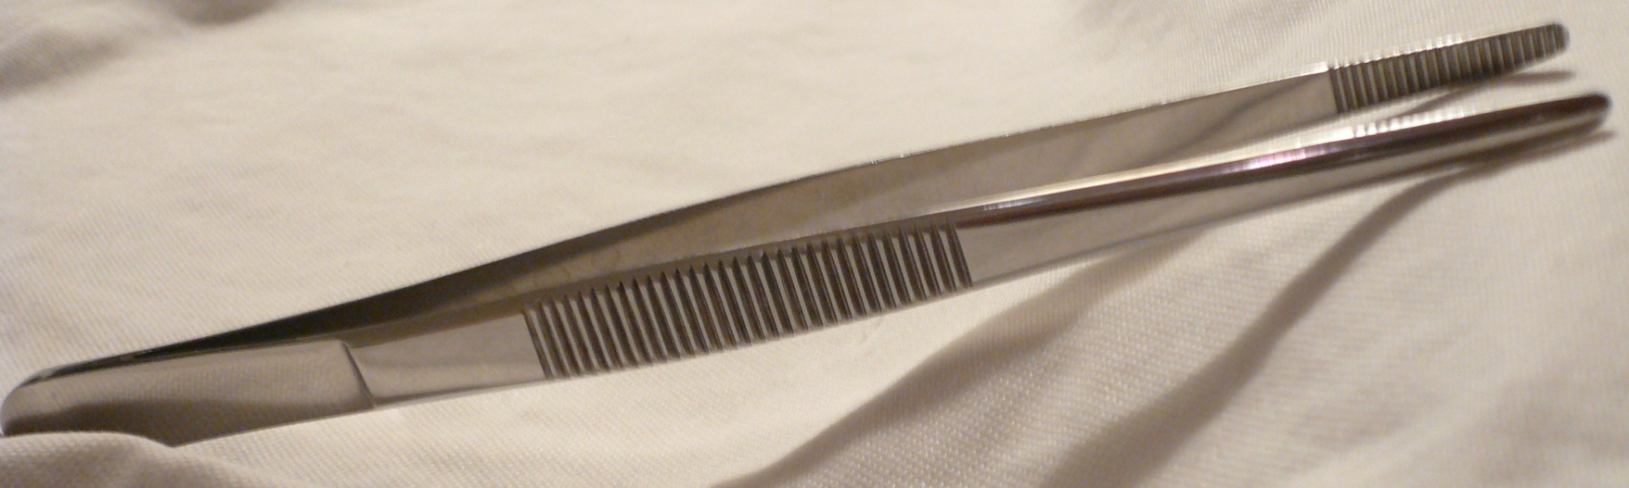
Plain Thumb Forceps
Used to hold tissue in place when applying sutures
Used to gently move tissues out of the way during exploratory surgery
Used to insert packing into or remove objects from deep cavities

Slide 77
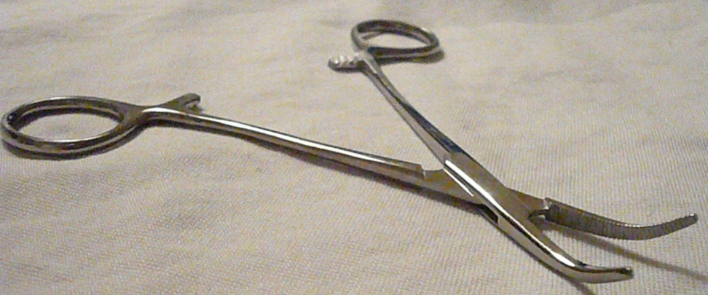
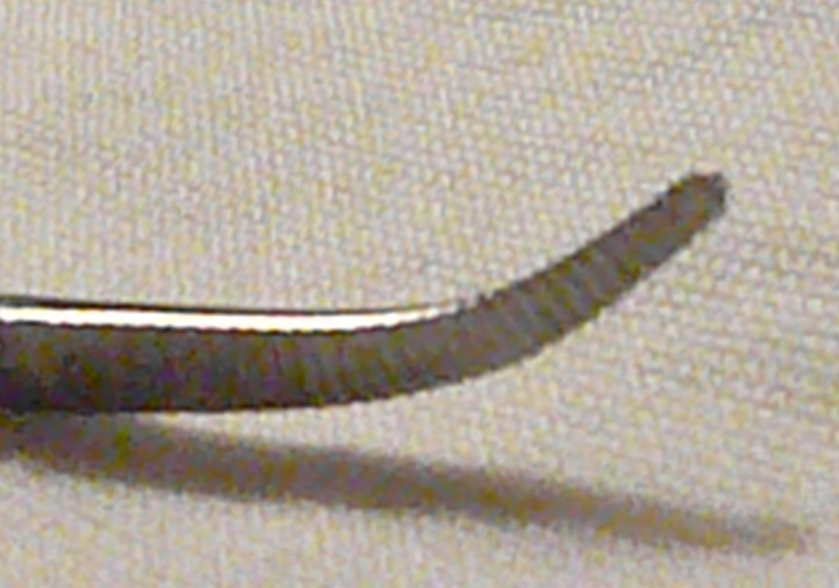
Curved Mosquito Hemostat
Used to hold delicate tissue
Used to compress bleeding vessels
Jaws are fully serrated

Slide 78
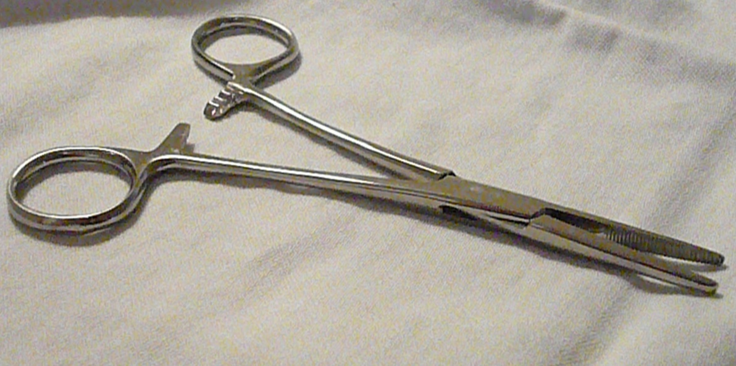
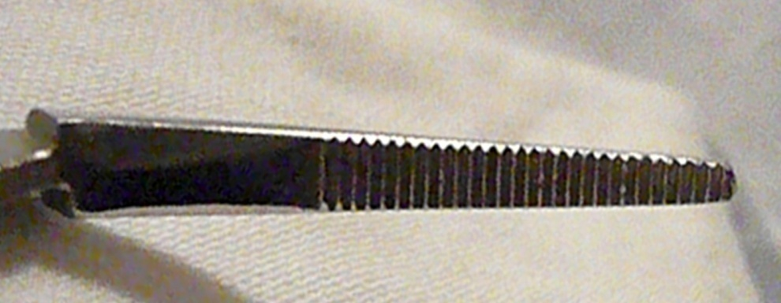
Kelly Hemostat
Used to clamp small vessels or hold tissue
Jaws are partially serrated
Curved or straight

Slide 79
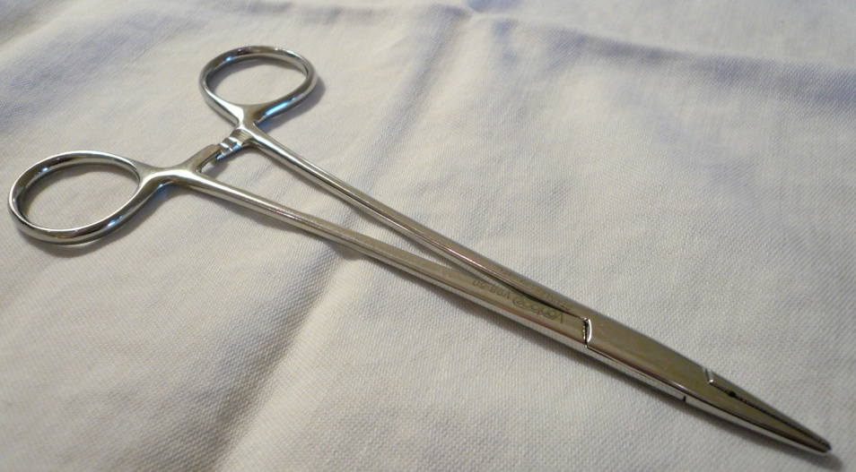
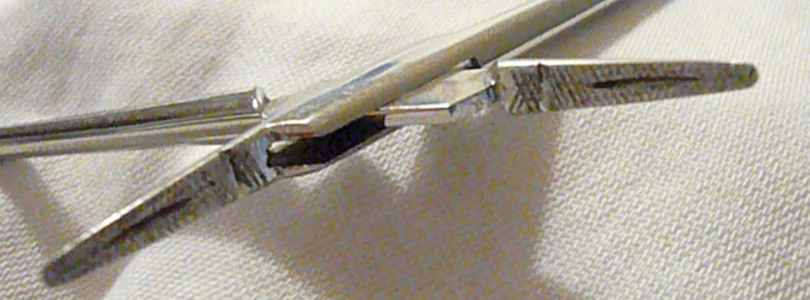
Needle Holder
Used to hold and pass a suturing needle through tissue
Has groove to hold needle within jaws

Slide 80
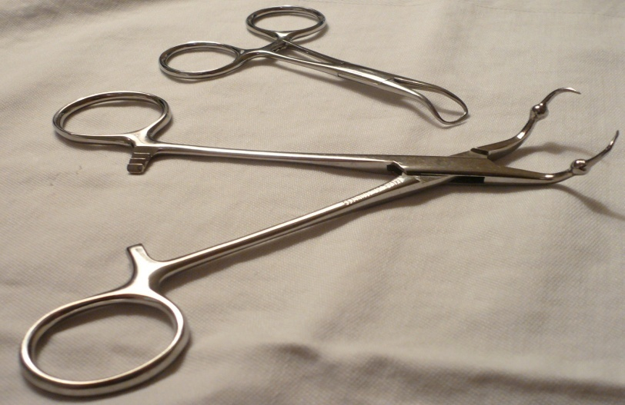
Towel Clamp
Adds weight to drapes and towels to ensure they stay in place
Allow exposure of the operative site

Slide 81
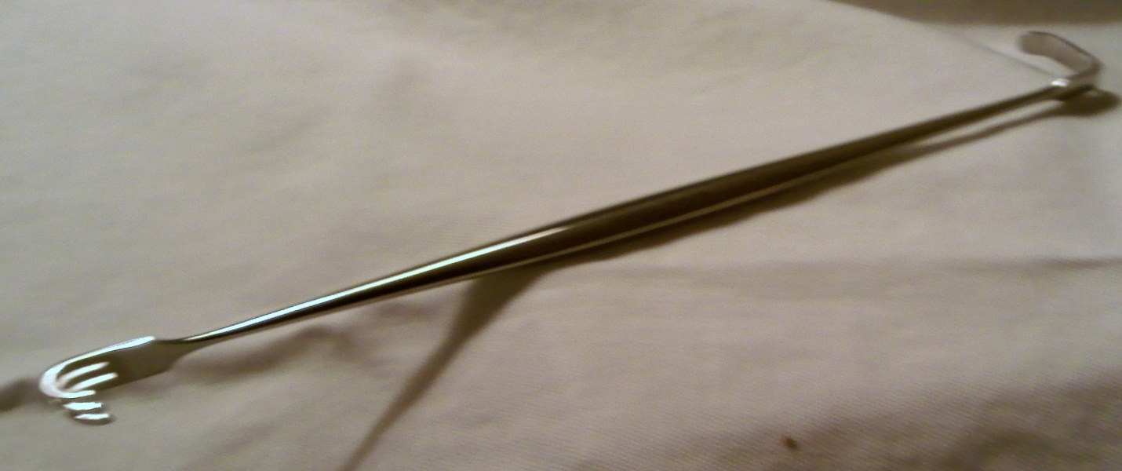
Skin Hook
Flat end is a blunt retractor
Three-prong end may be sharp to dull
Used to retract small incisions or secure a skin edge for suturing

Slide 82
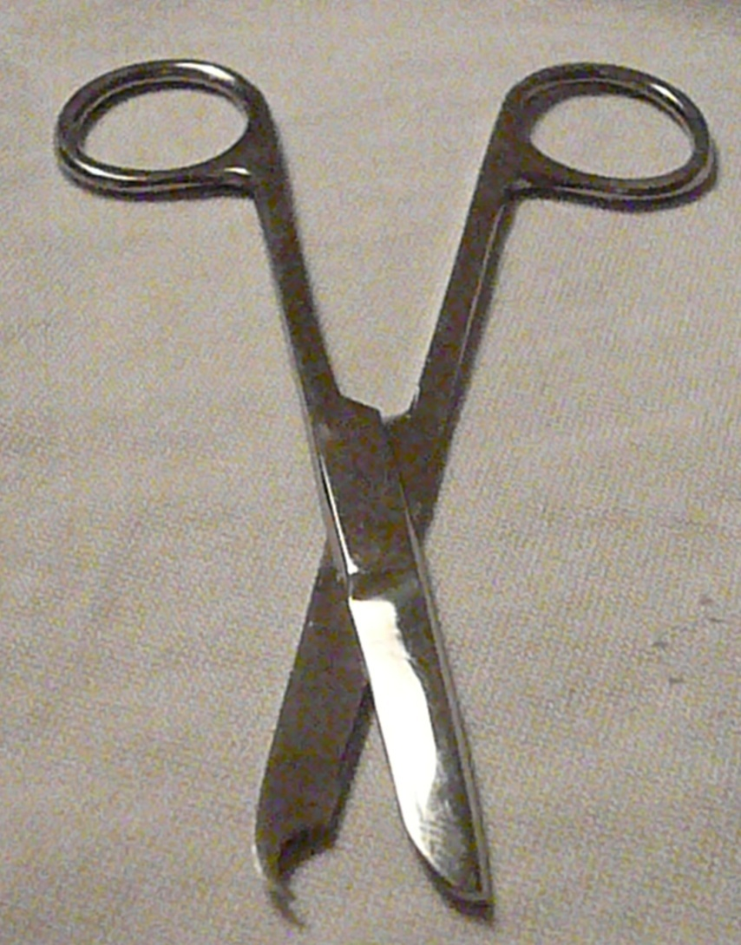
Iris Suture Scissors
Used to remove sutures
Blade has beak or hook to slide under sutures

Slide 83
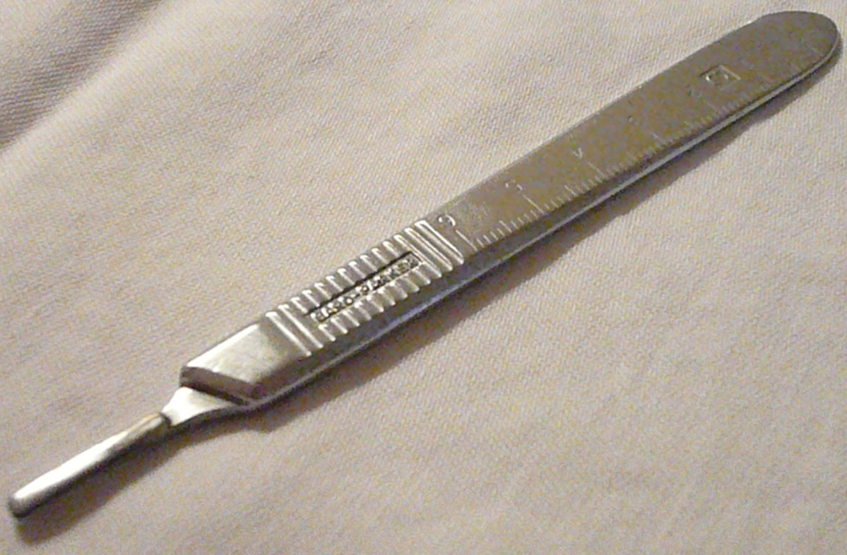
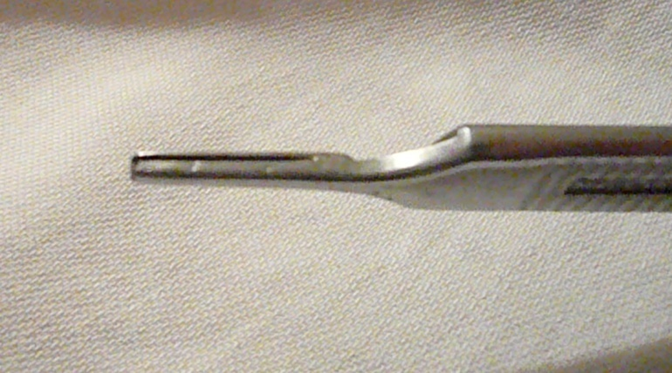
Scalpel Holder
Holds scalpel blade
Acts as a handle

Slide 84
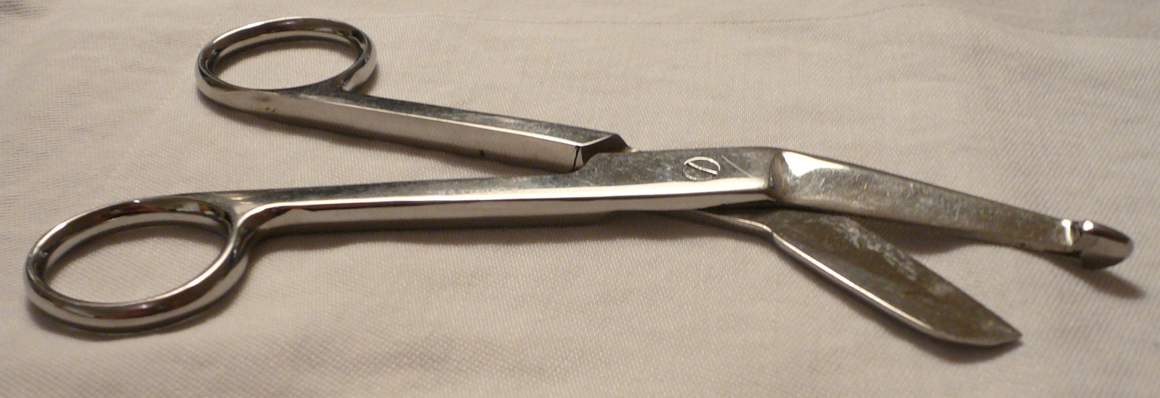
Lister Bandage Scissors
Used to remove bandages and dressings
Probe tip is blunt; inserted under bandages with relative safety

Slide 85
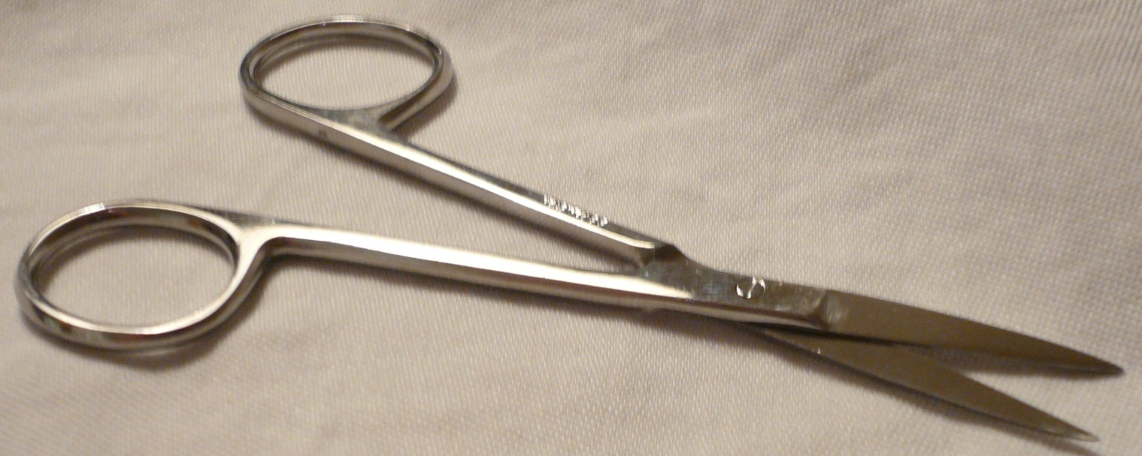
Sharp/Sharp Scissors
Used to cut and dissect tissue
Both blade tips are sharp

Slide 86
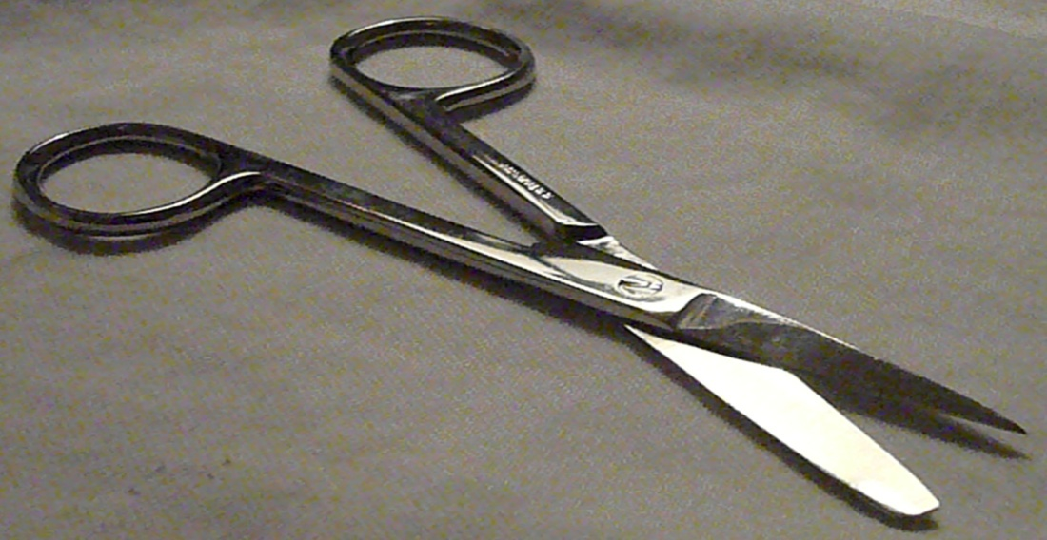
Sharp/Blunt Scissors
Used to cut and dissect fascia and muscle
One blunt tip and one sharp tip

Slide 87
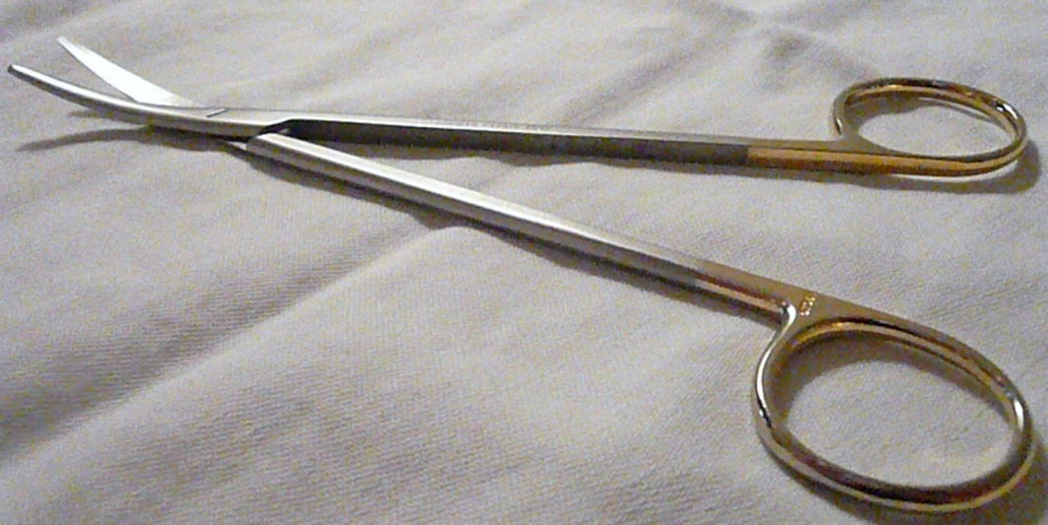
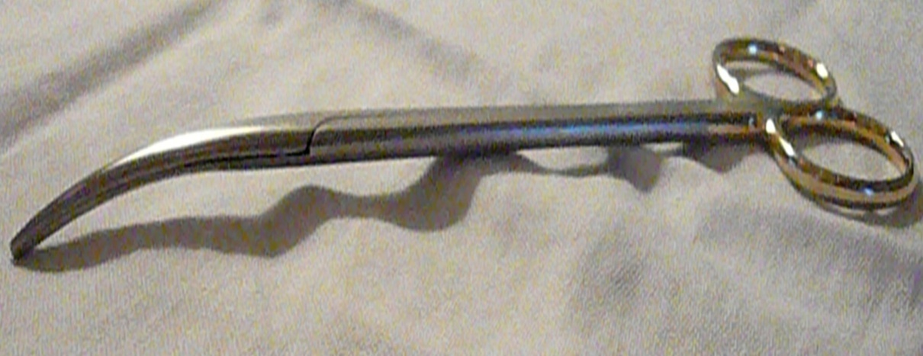
Curved Blunt/Blunt Scissors
Both blade tips are blunt
Can be curved or straight

Slide 88
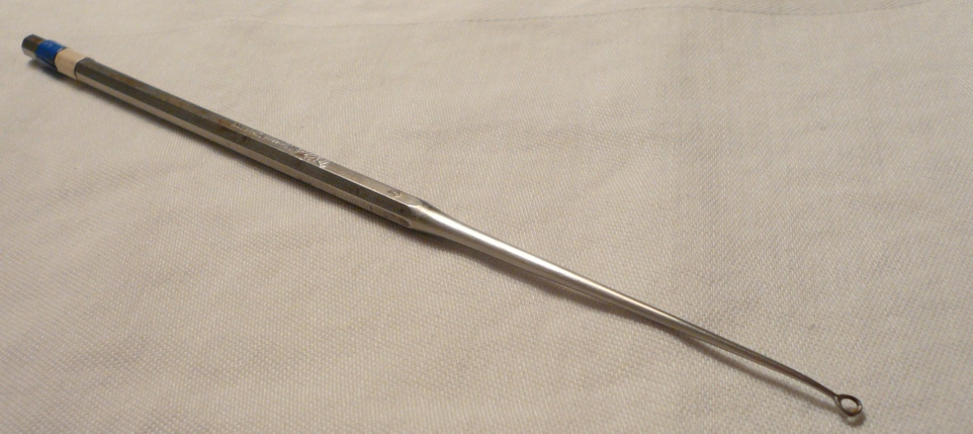
Ear Currette
Can have sharp or blunt scraper ends
Used to remove ear wax from ear canal

Slide 89
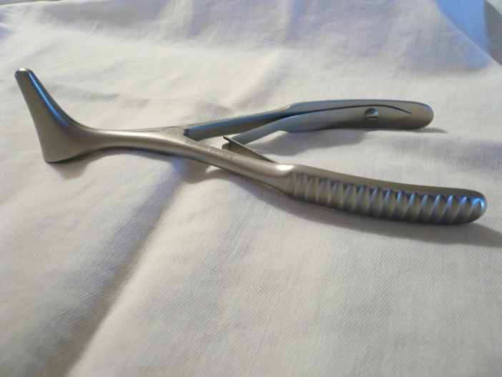
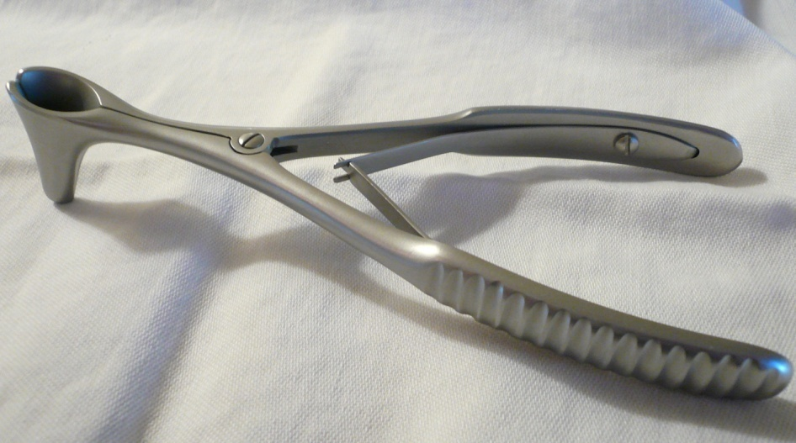
Nasal Speculum
Used to spread nostrils during examination

Slide 90
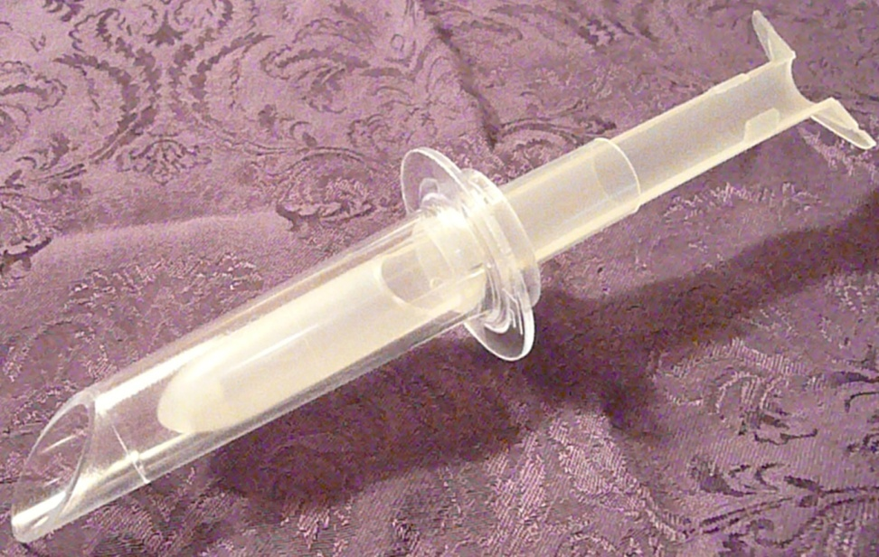
Anoscope with Obturator
Used to visualize the rectum and lumen of the sigmoid colon
Used to examine anal canal and distal aspect of the rectum
Consists of a stylus or removable plug (Obturator) used during the insertion of many tubular instruments (Anoscope).

Slide 91
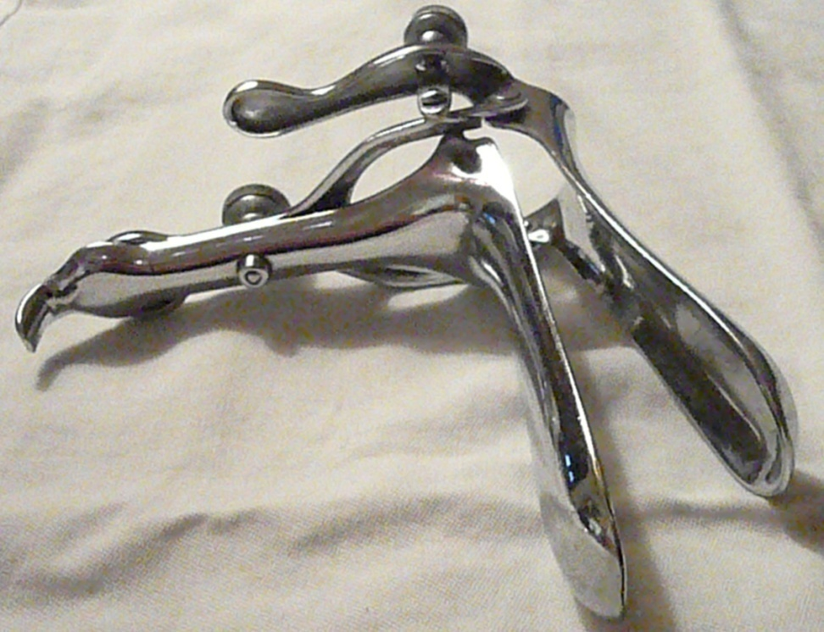
Vaginal Speculum
Used during gynecological exam or procedure
Dilates the opening of the vaginal cavity, allowing for inspection of the vagina and cervix
Facilitates access for observation and treatment

Slide 92
ANAESTHESIA
DFN- this is the loss of pain and sensation to a part or the whole body induced by drugs
Types
Local
General Anesthesia

Slide 93
General anesthesia
Totally Reversible Induced Pharmacological type of Unconsciousness so it can be differentiated from sleep, head injury, hypnosis, drug poisoning , coma or acupuncture

Slide 94
Components of anesthesia
The famous components of general anesthesia are
TRIAD
1. Uncosciousness.
2. Analgesia
3. Muscle relaxation.

Slide 95
TYPES
a)Inhalations
-These are inform of gases or volatile agents. They are used to maintain anesthesia
-Inhalational anesthesia is achieved through airway tract by facemask, laryngeal mask or endo-tracheal tube

Slide 96
Inhalational anesthesia depresses the brain from the cortex to the medulla by increasing dose.
They include :
Ether
Halothane

Slide 97
Nitrous oxide
Enflurane
Isoflurane
Desflurane
sevoflurane

Slide 98
b) Intravenous
used for induction of anesthesia
The primary targets of IV anesthetic agents are ionotropic (ion channel-linked) receptors for the endogenous neurotransmitters glutamate, the principal excitatory transmitter, or γ-aminobutyric acid (GABA), the principal inhibitory transmitter.

Slide 99
GABA( gamma amino butylic acid)slows the activity of nerve cell in the brain

Slide 100
-Very rapid: 10 seconds to 10 minutes
-They are used in combination with muscle relaxants and analgesics
-They include;
Thiopental
Etomidate
Propofol
Ketamine

Slide 101
Muscle relaxants
They include;
Suxamethonium ( scoline)
Curare
Flaxedil
Pancuronium

Slide 102
ANALGESICS
Includes;
pethidine
Morphine
Fentanyl
Assignment – discuss the care of a patient before induction of general anaesthesia

Slide 103
LOCAL ANAESTHESIA
This is used to induce analgesia where it is administered
The act by blocking the action potential of the area the have been administered by blocking the sodium channels

Slide 104
TYPES
Infiltration anesthesia
-This is by direct injection into tissues to reach nerve branches and terminals
-Used in minor surgery
-Drug used is lidocaine
b) Surface anesthesia- used in form of spray-lidocaine, tetracaine, dibucaine and benzocaine

Slide 105
c) Nerve block –the nerve supplying the area is infiltrated with the anesthetic drug, inducing loss of sensation on the area. Lidocaine is commonly used
e.g. –used in dental surgery
d)Field block- common with nerve block but involves more than one nerve

Slide 106
e) Epidural anesthesia- anesthetic drug is injected in the epidural space blocking the spinal roots.
- Drug used are lidocaine and bupivacaine
Used for surgery’s of the abdomen and below
f) Spinal anesthesia- anesthetic drug is injected into the subarachnoid space

Slide 107
Sometimes a lumbar puncture is done before injecting the drug
Paralysis is achieved below the level of the puncture
Used for surgery to the abdomen, pelvis or lower part of the body when general anesthesia cannot be used
Mainly used drug is lidocaine

Slide 108
Electrosurgery
Electrosurgery is a term used to describe multiple modalities that use electricity to cause thermal destruction of tissue through dehydration, coagulation, or vaporization.
The two types of electrosurgery most commonly used are monopolar and bipolar

Slide 109
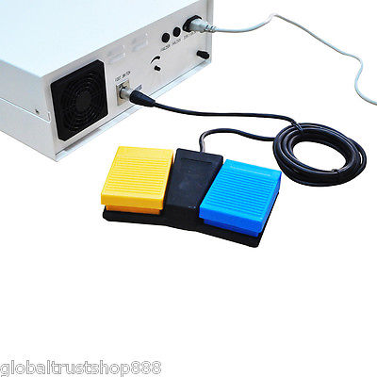
Electrosurgical unit(surgical diathemy)
Return pad

Slide 110
Monopolar electro surgery
Current passes from the probe electrode, to the tissue and through the patient to a return pad to complete the circuit
Return electrode pad is attached to the patient, so the electrical current flows from the generator to the electrode through the target tissue, to the patient return pad and back to the generator.
Is the most commonly used because of its versatility and effectiveness.

Slide 111
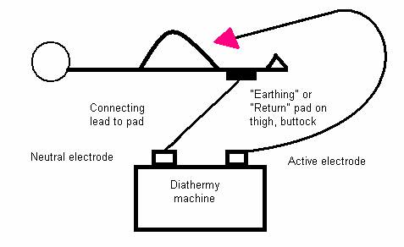
Monopolar

Slide 112
Bipolar electro surgery
The current only passes through the tissue between the two arms of the forceps shaped electrode (visualize the tip of a pair of tweezers.)
Current in the patient is restricted to just the tissue between the arms of the forceps electrode.

Slide 113
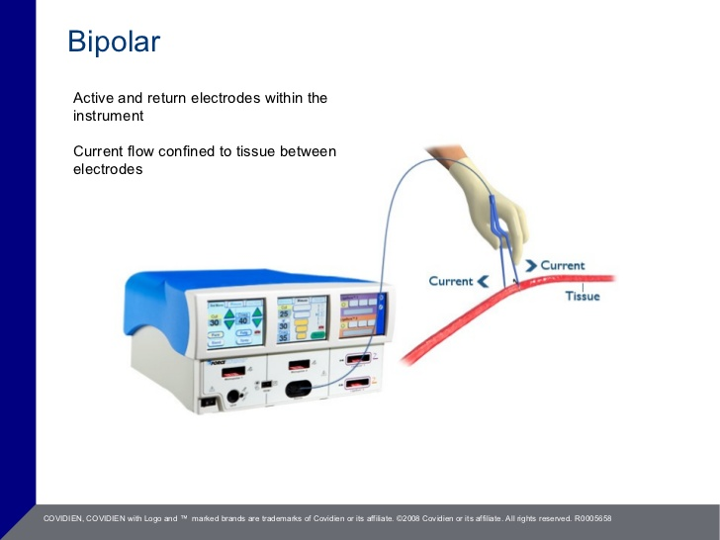

Slide 114


Slide 115
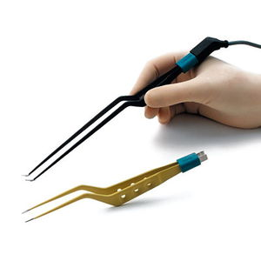

Slide 116
Pros and cons
Bipolar electrosurgery uses lower voltages so less energy is required.
But it has limited ability to cut and coagulate large bleeding areas, so it is limited to procedures where tissues can be easily grabbed on both sides by the forceps electrode.
Current is confined to the tissue between the two electrodes, the risk of patient burns is reduced

Slide 117
So it can be used in patients with implanted devices to prevent electrical current passing through the device causing a short-circuit or misfire.
It is always recommended to review the implanted device user manual prior to preforming any electrosurgical application, to avoid complications.
NB: Electrosurgery can be risky even to staff

Slide 118
ROLES OF THE THEATRE NURSES
Receiving area nurse
- May double up as the anesthetic nurse
- Receive patient from the ward and counter checks the documents if they are the right ones

Slide 119
b) Anaesthetic nurse
work besides the anesthetist before surgery and ensures the anesthetic machine is in good working condition
Ensures that all the drugs needed for induction maintenance and reversing are available
All equipment for intubation are available

Slide 120
Visit the patient pre-operatively to assess the condition of the patient ( re-assure the patient and assess need of extra equipments during anesthesia)
Observation of the patient throughout the surgery
Receive the patient from the scrub nurse and hand over to the recovery area nurse

Slide 121
c) Scrub nurse
May be one or more depending on the type of surgery
Prepare theatre for surgery and ensures availability of all equipments
Charged with responsibility of maintaining a sterile environment in theatre
arranges equipments around the theatre table and hands them to the surgeon appropriately

Slide 122
Count equipments at different closure of cavities to prevent loss in the body
Supervise the clearing of equipment after ascertaining a proper count
Act as an advocate for the patient- ensures that the right operation is done
Documents in the theatre notes activities carried out in theatre

Slide 123
d) Circulating nurse
- Work closely with the scrub nurse and take instructions from them
Assisting the scrub nurse with the laying of the instruments before surgery
Indicate when the tourniquet was applied and removed
Ensure that the extra equipments e.g diathermy are working

Slide 124
Help in the labeling of specimens and sending them to the lab
- Ensure the welfare of the theatre team
Recovery room nurse
Stationed in the recovery room
- Ensures that all drugs and equipments required are available before receiving the patient from the operating room

Slide 125
Observes the general condition of the patient , vital signs and maintains input output
Gives the stat drugs and any other drug that may be needed
Assess for any complications and alerts the surgeon
Indicates the operation done in the recovery register
Hand the patient to the ward nurse

Slide 126
f) Nurse administrator
- Is the overall administrator of theatre
Ensures staffing of theatre for 24 hours and their safety
Orients new staff in theatre

Slide 127
Ensures availability of equipments needed in theatre
Liase with other departments in the hospital for smooth running of theatre
Maintains discipline in theatre

Slide 128
Principles of post-operative care
Ensure clear airway
Supporting circulation
Controlling bleeding
Preventing infection
Monitoring any complications
Controlling pain
Ensuring return of
GI motility
Ensuring easy ambulation
Preparing the
patient for dx and home-based care

Slide 129
Ensuring clear airway
Supporting circulation – this helps maintain the lungs, heart and the kidney with adequate blood volume. IV infusions are maintained during theatre
Amount of fluid required= maintenance requirement + fluid loss( loss during operation + normal body loss + insensible loss)

Slide 130
An adult requires 35mls/kg/24hrs
( maintenance)
Insensible loss is approximately 0.5 ml/kg/hr
(skin, faeces and breathing )
Below three months maintenance 5mls/kg/hr

Slide 131
Above three months( weighing 3-10kg)- 5mls/kg/hour
10-20kgs – 3ml/kg/hr
Above 20kg – 2.5mls/ kg/hr

Slide 132
Controlling bleeding and wound care
- Monitor the patient for signs of bleeding from the suture line and vitals
After 24hrs check for signs of infection
( redness, tenderness, edema and low grade fevers )

Slide 133
Preventing infection
Administration of prophylactic antibiotics[PRN]
Maintaining infection prevention

Slide 134
Monitoring of complications
Vital observations after every 15 mins for 2hrs, 30 mins for the next 2hrs then 4 hourly
Other observations depending on the type of surgery e.g. urine output , hemorrhage, GCS etc

Slide 135
Controlling pain
Giving of pethidine ( 50- 100mg ) or morphine
for 24hrs
- Positioning of the patient

Slide 136
Ensuring gastro-intestinal motility
Access for return of bowel sounds and passing of flatus
Ensure adequate hydration
Decompress the stomach by use of NG tube
On return of bowel sounds give oral sips, fluid diet, light diet then normal diet

Slide 137
Ensuring early ambulation
This prevents DVT and hypostatic pneumonia
Encourage the patient to move out of bed as soon as the condition allows
Give anticoagulants for those who will be in bed for a long time
Encourage the patient to do breathing exercises in bed

Slide 138
Prepare the patient for discharge and home based care
Prepare the patient with the things needed for recovery at home
Social worker to access the home if need be before the patient is discharged and give recommendations
Modification of the home environment if need be for coping of the patient

